Slide 1
Evaluating Development Plans and their Positional Stance with Green Development Goals
TEAM MEMBERS
GAUTHAM MENON 19BCE1596
JIGYASA SARASWAT 19BCE1706

Slide 2
INTRODUCTION
The United Nations Development Program (UNDP) allows countries to grow out their sustainable development goals which are targeted at the sections of the society that require uplifting to improve their socio-economic conditions of living.
As countries create their infrastructural as well as economic plans, they can avail a service from the UNDP to review the defined plan and see how many such ideas work in tandem with UNDP’s Sustainable Development Goals, which are known as Rapid Integrated Assessment.

Slide 3
AIM AND MOTIVATION
The project aims at overcoming the tremendous amount of bureaucracy and paperwork that goes into international matters even when it comes to matters of common agreeance such as sustainable development, which is why numerous countries have opted out of such programs. This brings a larger set of nations under the fold of sustainable growth in the long run.
The process is generally very labor intensive and time consuming as it requires manual checking of hundreds of documents and matching them with RIA regulations.

Slide 4
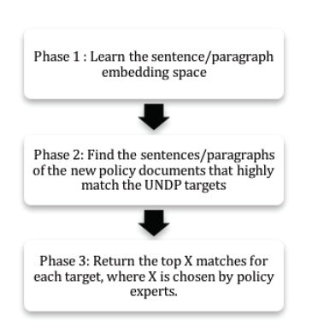
IMPLEMENTATION
The project aims at using Semantic search techniques as well as Paragraph vectors to match and find out the number of development goals that align with the views of the RIA. Ideally, with a higher hit-rate, the more aid UNDP sanctions, thereby allowing for a faster development for the country. So creating either a Hit-rate or a match% to evaluate the document and thereafter creating a minimum threshold that the match% must clear in order to accelerate the development process.

Slide 5
THANK YOU

